Slide 1
Problem Solving
Define Problem Solving
Strategies for Problem Solving

Slide 2




Definition
www.tuf.edu.pk
unioffaisalabad
Problem solving is a cognitive process that involves identifying, analyzing, and finding solutions to complex issues or challenges. It encompasses various mental processes, including reasoning, decision-making, and critical thinking. In psychology, problem solving is studied to understand how individuals approach hurdles and make decisions in everyday life.

Slide 3


Strategies for Problem Solving
www.tuf.edu.pk
unioffaisalabad
1. Understanding the Problem:
Clearly define the problem.
Break it down into smaller, manageable parts.
Gather relevant information.
2. Generating Possible Solutions:
Brainstorm multiple solutions without judgment.
Use creative thinking techniques, such as mind mapping or free writing.
Brainstorm to try to solve a problem or come up with new ideas by having a discussion that includes all members of a group.
Mind mapping is a creative process to make associations and recognize patterns among various concepts and ideas.

Slide 4
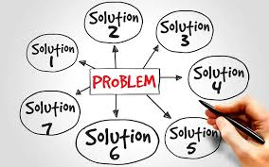

Strategies for Problem Solving
www.tuf.edu.pk
unioffaisalabad

Slide 5
Strategies for Problem Solving
www.tuf.edu.pk
unioffaisalabad
3. Evaluating Solutions:
Assess the feasibility and potential outcomes of each solution.
Consider the pros and cons of each option.
4. Selecting a Solution:
Choose the most valuable solution based on evaluation.
Ensure the chosen solution aligns with the desired outcomes.

Slide 6
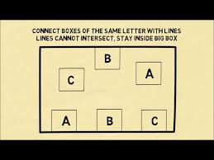
Strategies for Problem Solving
www.tuf.edu.pk
unioffaisalabad

Slide 7
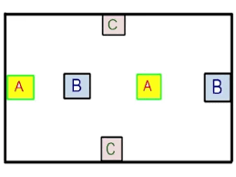
Strategies for Problem Solving
www.tuf.edu.pk
unioffaisalabad

Slide 8
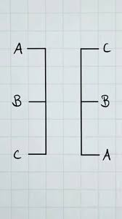
Strategies for Problem Solving
www.tuf.edu.pk
unioffaisalabad

Slide 9
Strategies for Problem Solving
www.tuf.edu.pk
unioffaisalabad
5. Collaborative Problem Solving:
Engage others to gain different perspectives.
Use group discussions to foster collective problem-solving.
6. Using Heuristics:
Apply mental shortcuts or rules of thumb to simplify decision-making.
Examples include the availability heuristic and representativeness heuristic.
Examples
A person is stuck in traffic and makes an impulsive decision to take the other route even though you don't know the way.
Someone is offered a job and accepts it without further details.
A family chooses to move to another country without being familiar with the language, culture or area.

Slide 10
Strategies for Problem Solving
www.tuf.edu.pk
unioffaisalabad
7.Employing Algorithms:
Use step-by-step procedures or formulas for systematic problem-solving.
Algorithms are particularly useful in mathematical or logical problems.
Example:
A recipe for cooking a particular dish.
8. Adapting Cognitive Styles:
Recognize personal cognitive biases and adjust problem-solving approaches accordingly.
Be aware of different thinking styles (e.g., analytical vs. intuitive) and use them effectively.

Slide 11
Strategies for Problem Solving
www.tuf.edu.pk
unioffaisalabad
Intuitive decision-making can be efficient, flexible, but it can also be biased, inconsistent, or irrational.
Example
Choosing the same kind of coffee everyday because you are happy with how it tastes is a good example.
2. Analytical decision-making can be precise, systematic, and logical, but it can also be time-consuming, rigid, or complex.
Example
Analytics in the legal industry involves collecting and analyzing relevant data, such as case documents, court decisions, and legal precedents. This data is then used to train statistical models and algorithms, which can make predictions based on patterns

Slide 12

Give Caption
www.tuf.edu.pk
unioffaisalabad

